Slide 1
Particle Swarm Optimization and Genetic Algorithms
John Ahn, Conor Belfield, Ryan St. Pierre
May 17, 2017

Slide 2
Road Map
Problem
How we approached it
How we tested
Results
Conclusions
Future work

Slide 3
Problem
Global minimization of multi-dimensional functions
We have established PSO as a fairly effective algorithm to find optimal solutions
Can we improve it?

Slide 4
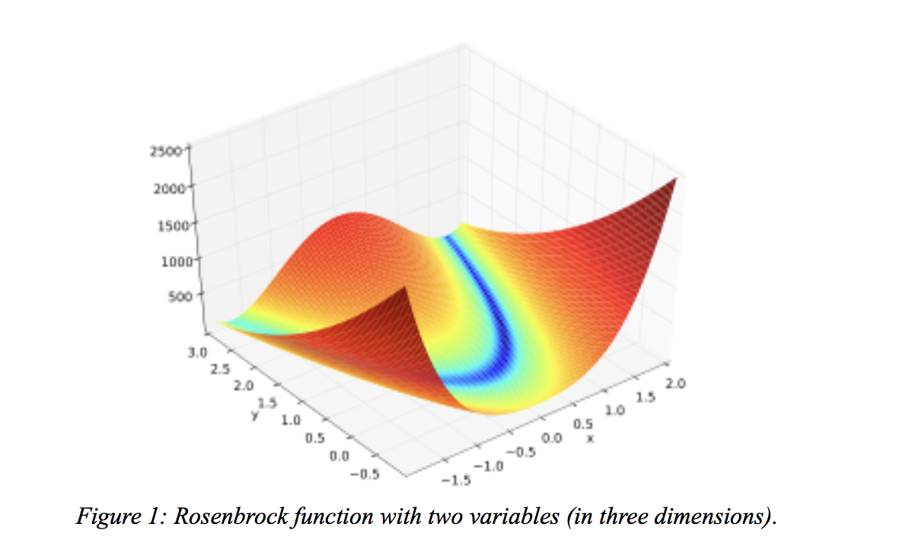
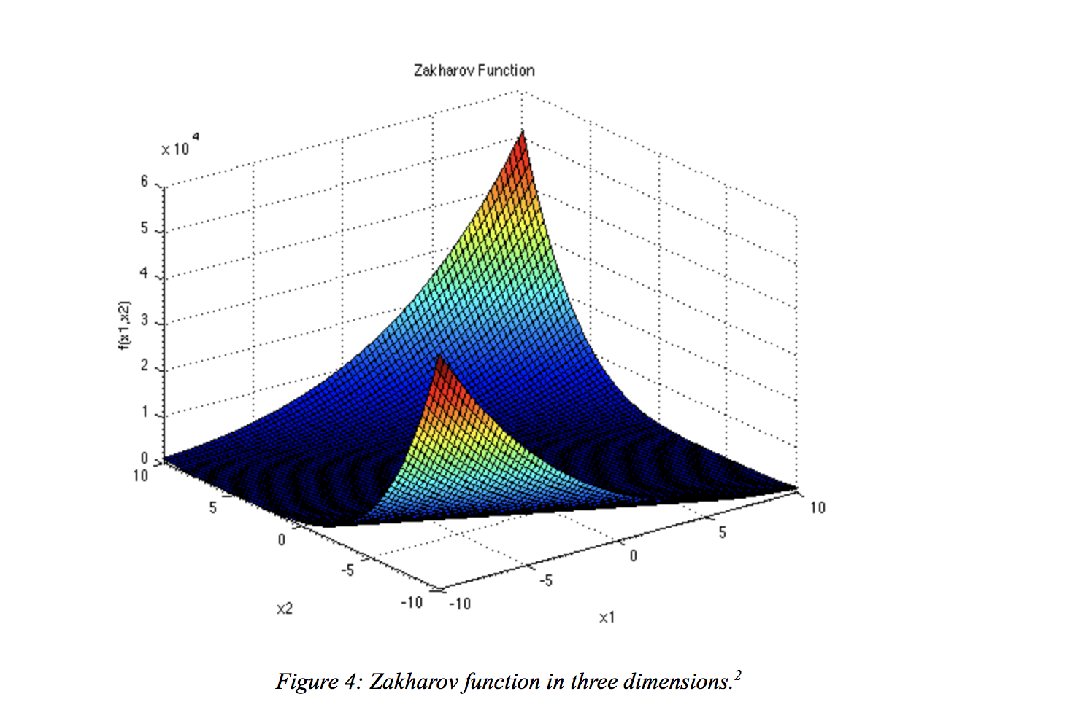
Problem

Slide 5
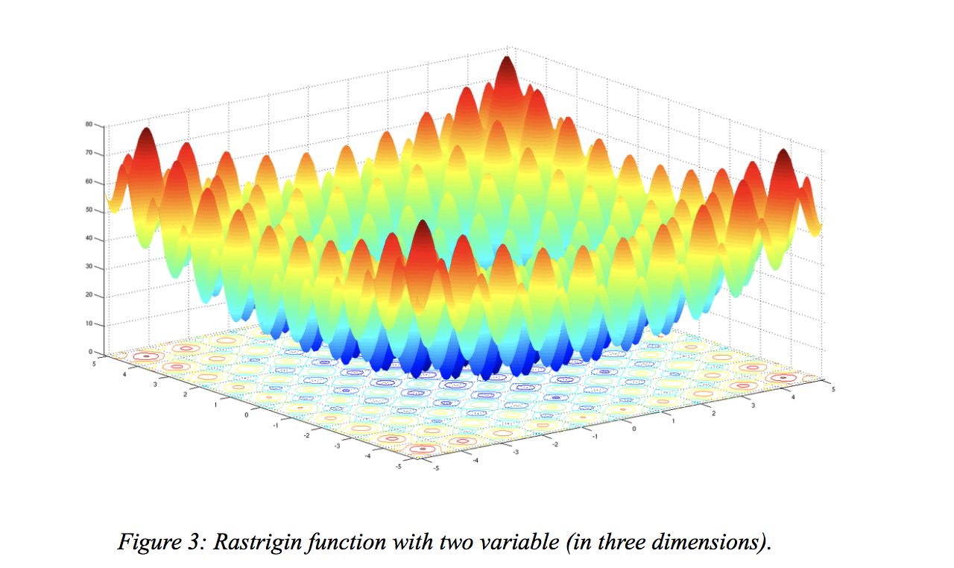
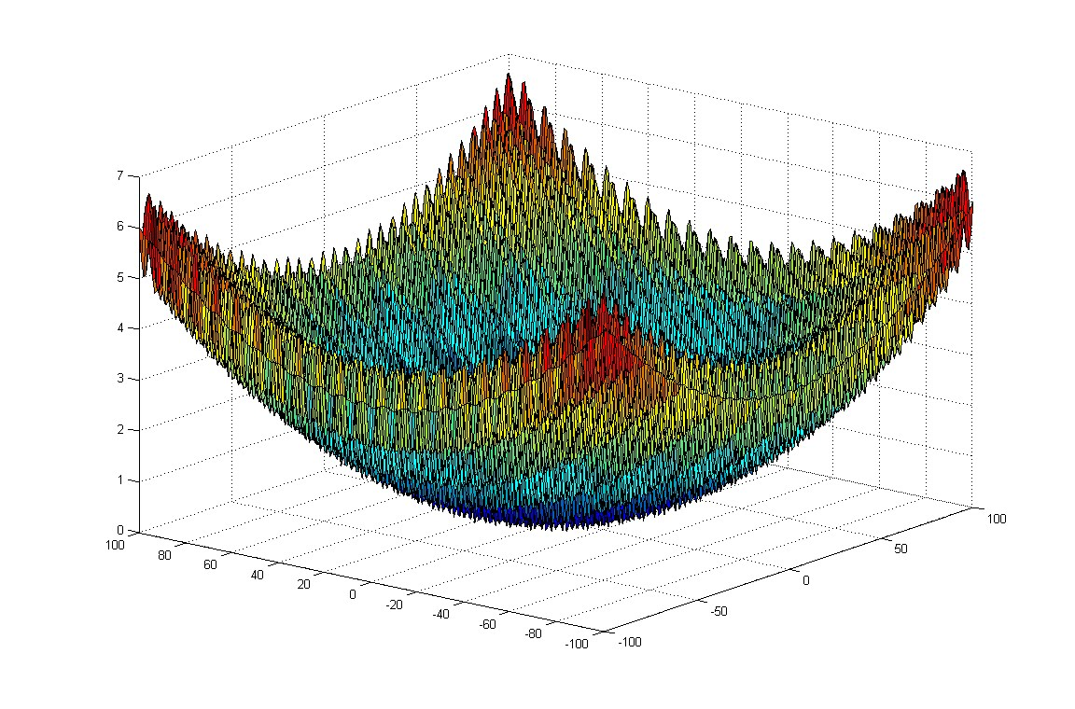
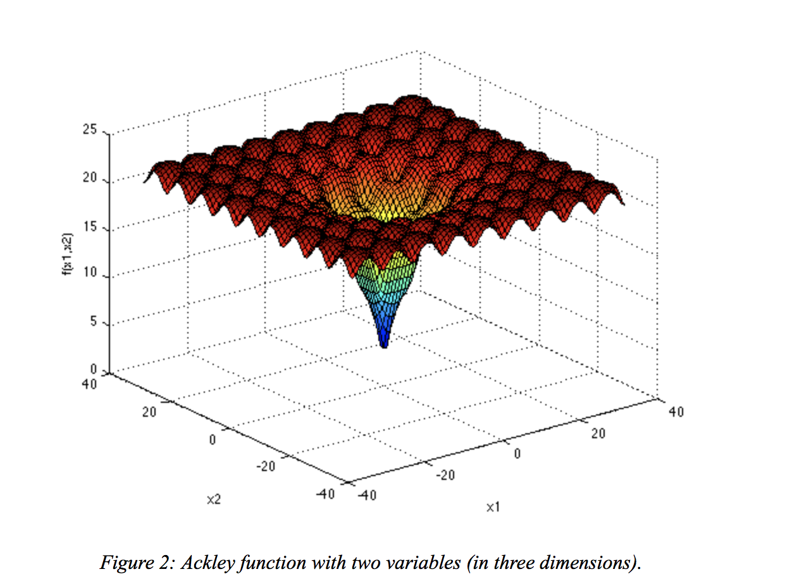
Problem
Griewank function

Slide 6
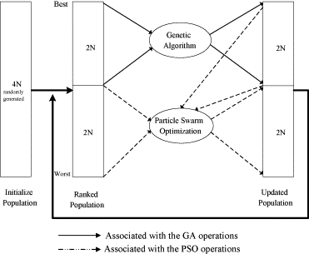
Our Approach
Implemented a Genetic Algorithm / PSO hybrid
For each iteration:
Evolve the better solutions by crossover and mutation
Iterate the entire swarm by PSO
Implemented with and without selection in GA
Goal: PSO but with an additional element of randomness

Slide 7
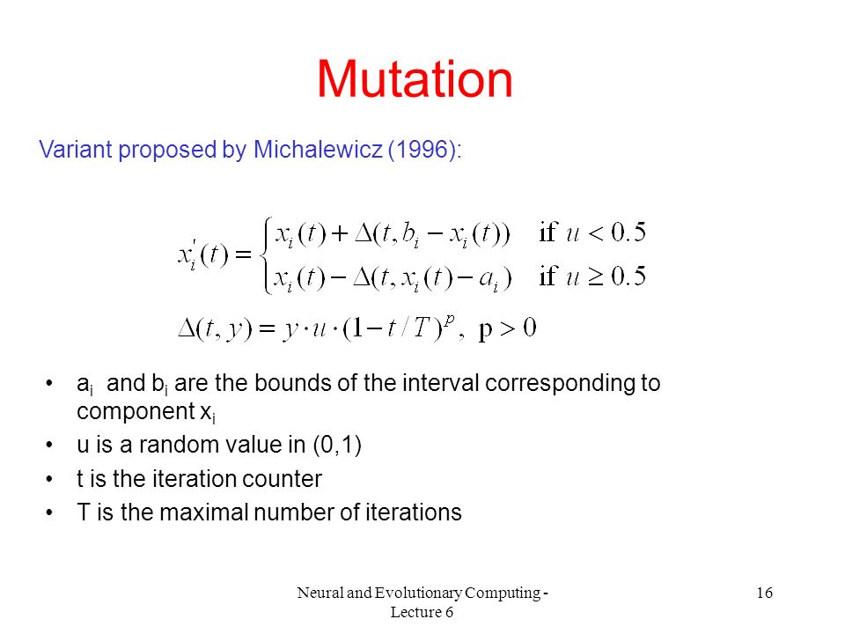
Hi!

Slide 8
Our Approach
Sort all particles by fitness
GA’s new look: Swaps coordinates rather than bits
No Selection
Mutate
Crossover
Provides aggressive randomness
PSO remains the same
Provides a safety net for the worst solutions
The Cut Ratio is now important
How much of the swarm to modify with GA?

Slide 9
Our Approach
Implemented PBIL to discover best Cut Ratio
Extremely impractical
Bit string representing exponential as individual
Shifted to attempt to test like other parameters - loop through values

Slide 10
Testing Methodology
We ran our PSO and Hybrid algorithms on the same five functions, comparing the rates of convergence and the quality of solution
As we are running a full GA and a full PSO, we are sacrificing time

Slide 11
Testing Methodology
Despite having results from the PSO, we were unsure if best parameters would transfer
Crossover Method
Neighborhood
Swarm size
Mutation Probability
Crossover Probability

Slide 12
Results: Why Selection is Bad
Results with no selection fairly close to minima
Selection results very far away from minima
As particles increase, tend to get better
Theory -> repeat values chosen
 |  |  |  | None
 |  | Rosenbrock | Ackley | Rastrigin | Griewank | Zakharov
 | 49 | 2.618054663 | 1.684386715 | 33.7686243 | 0.001479208 | 0.057826308
Particles | 144 | 0.769066109 | 1.684386715 | 41.34800437 | 0 | 0.000259963
 | 441 | 3.578886424 | 1.684386715 | 33.7686243 | 0 | 7.32901E-06
 |  |  |  | Tournament
 |  | Rosenbrock | Ackley | Rastrigin | Griewank | Zakharov
 | 49 | 78818128.83 | 20.17459615 | 399.0301063 | 344.4492205 | 24837.18125
 | 144 | 71279783.83 | 19.92225331 | 374.006999 | 366.5283368 | 16782.7127
 | 441 | 49551014.63 | 19.61513868 | 334.5665603 | 313.5418001 | 15222.67063
 |  |  |  | Rank
 |  | Rosenbrock | Ackley | Rastrigin | Griewank | Zakharov
 | 49 | 82234331.72 | 19.94415218 | 367.4403041 | 428.7402198 | 22588.55289
 | 144 | 67257126.81 | 19.9707453 | 357.0589799 | 389.2804516 | 17878.6142
 | 441 | 61378029.4 | 19.66612889 | 353.7000567 | 304.1885176 | 16329.25089
 |  |  |  | Boltzman
 |  | Rosenbrock | Ackley | Rastrigin | Griewank | Zakharov
 | 49 | 85218349.25 | 20.09082215 | 397.490529 | 420.7102566 | 14978.69123
 | 144 | 91269798.77 | 19.94128388 | 381.9729743 | 400.7250509 | 12509.84772
 | 441 | 73537645.82 | 19.63787939 | 344.7716083 | 353.9770545 | 10655.63895

Slide 13
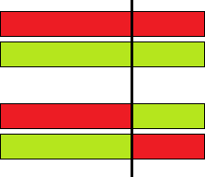
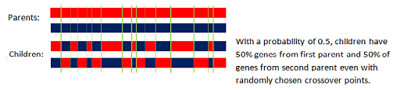
1-point Crossover
Uniform Crossover

Slide 14
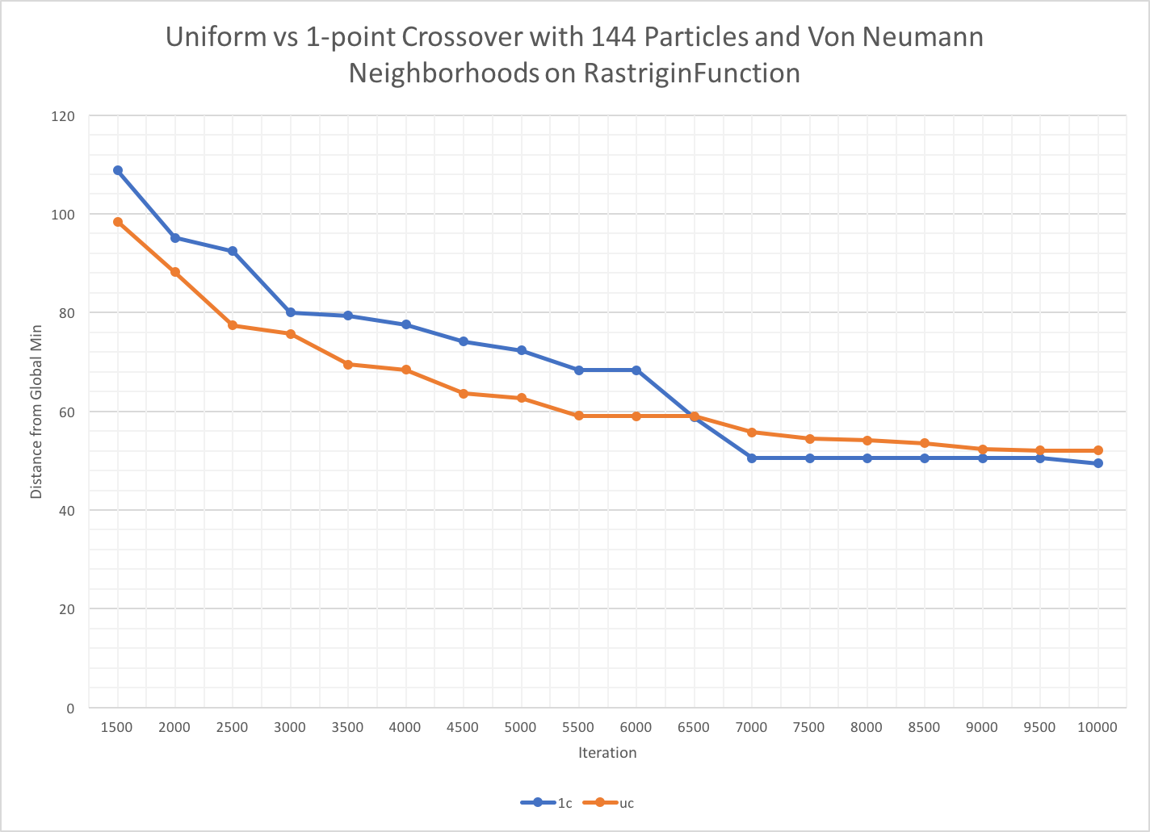
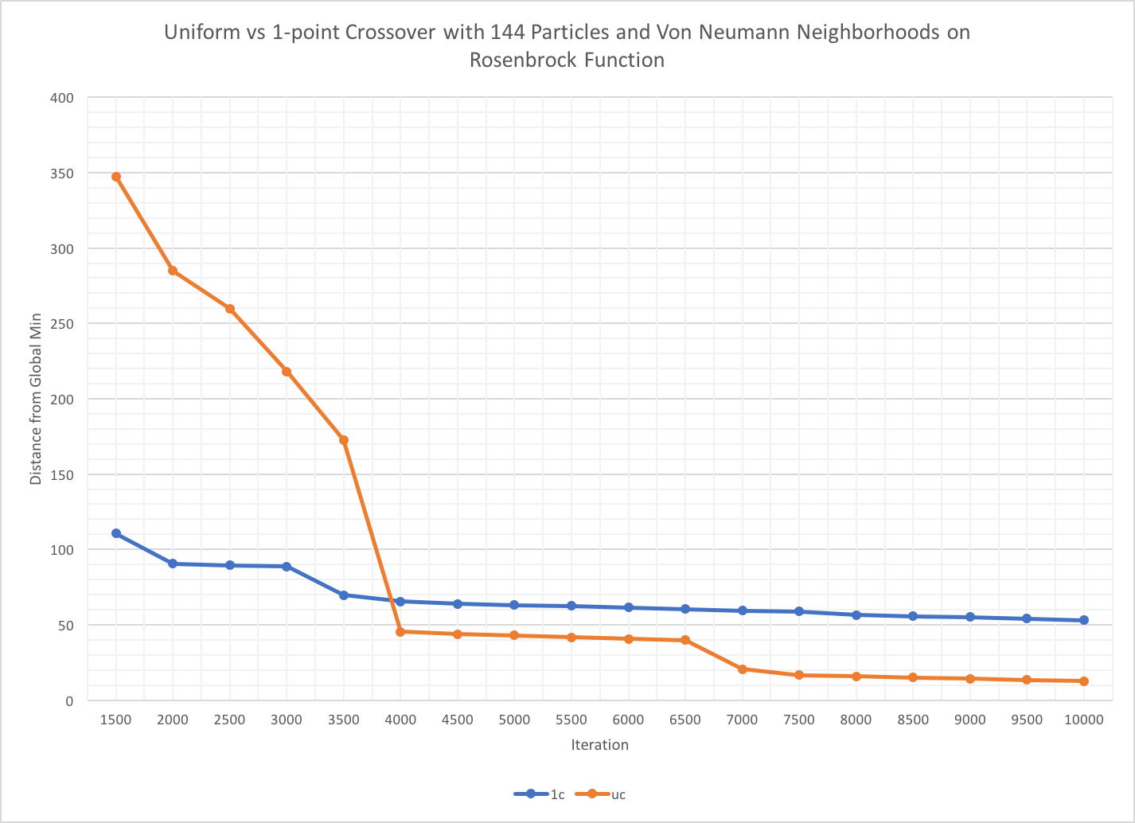
Results: Uniform vs. 1-Point (Uniform)

Slide 15
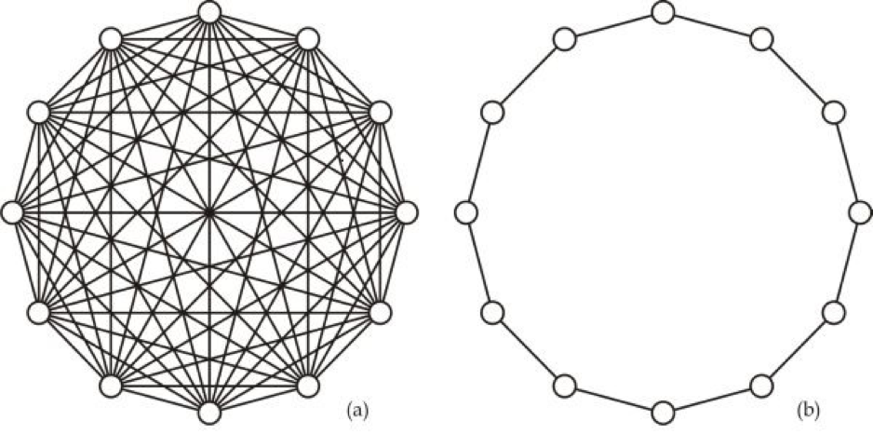
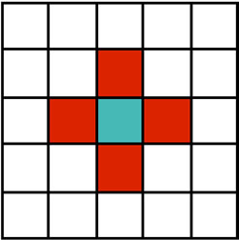
Global Ring Von Neumann

Slide 16
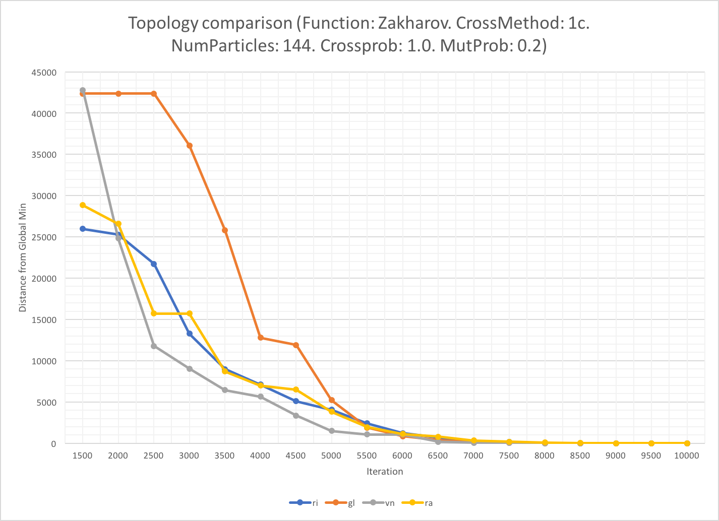
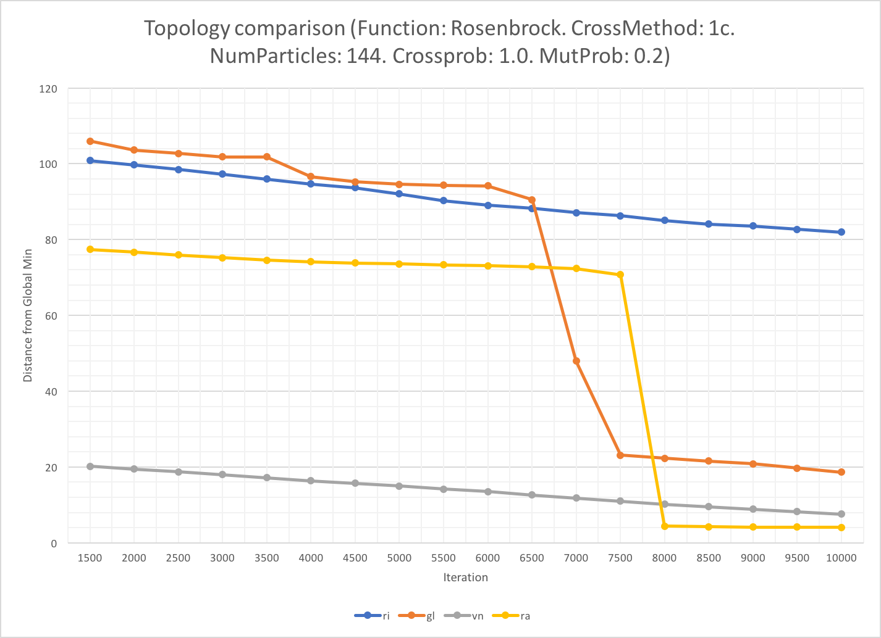
Results: Neighborhood (Von Neumann)

Slide 17
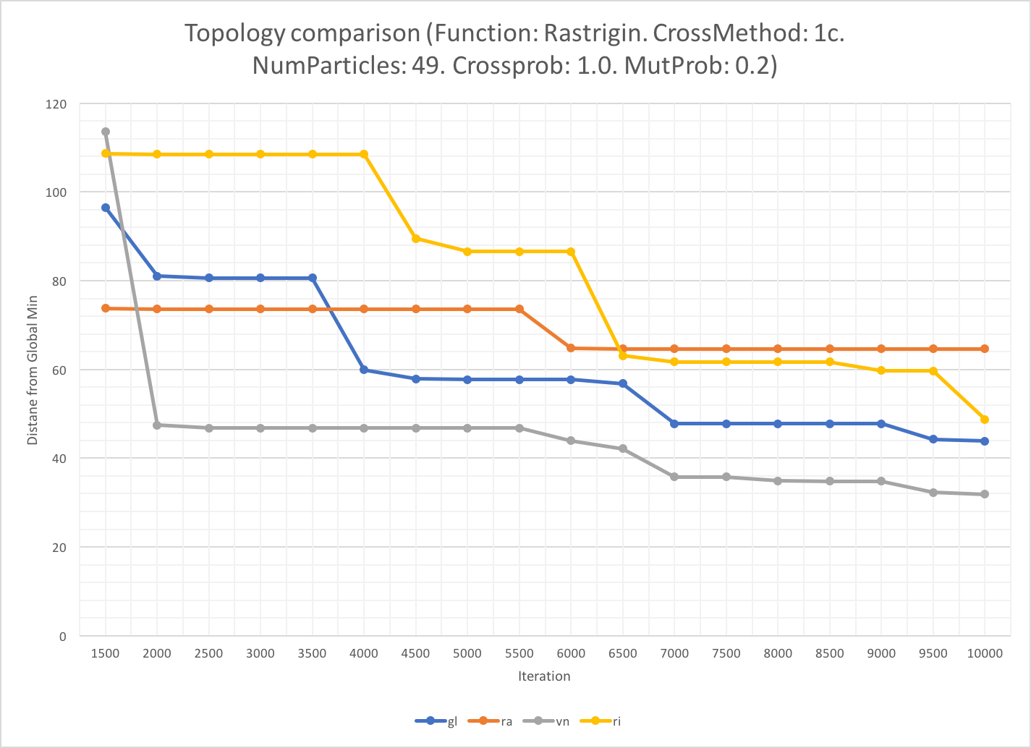
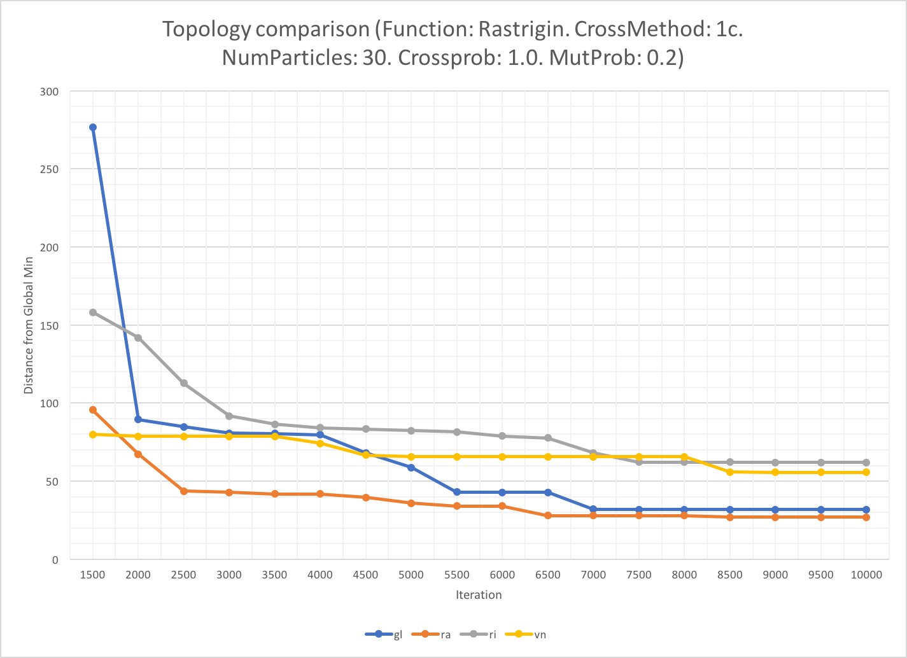
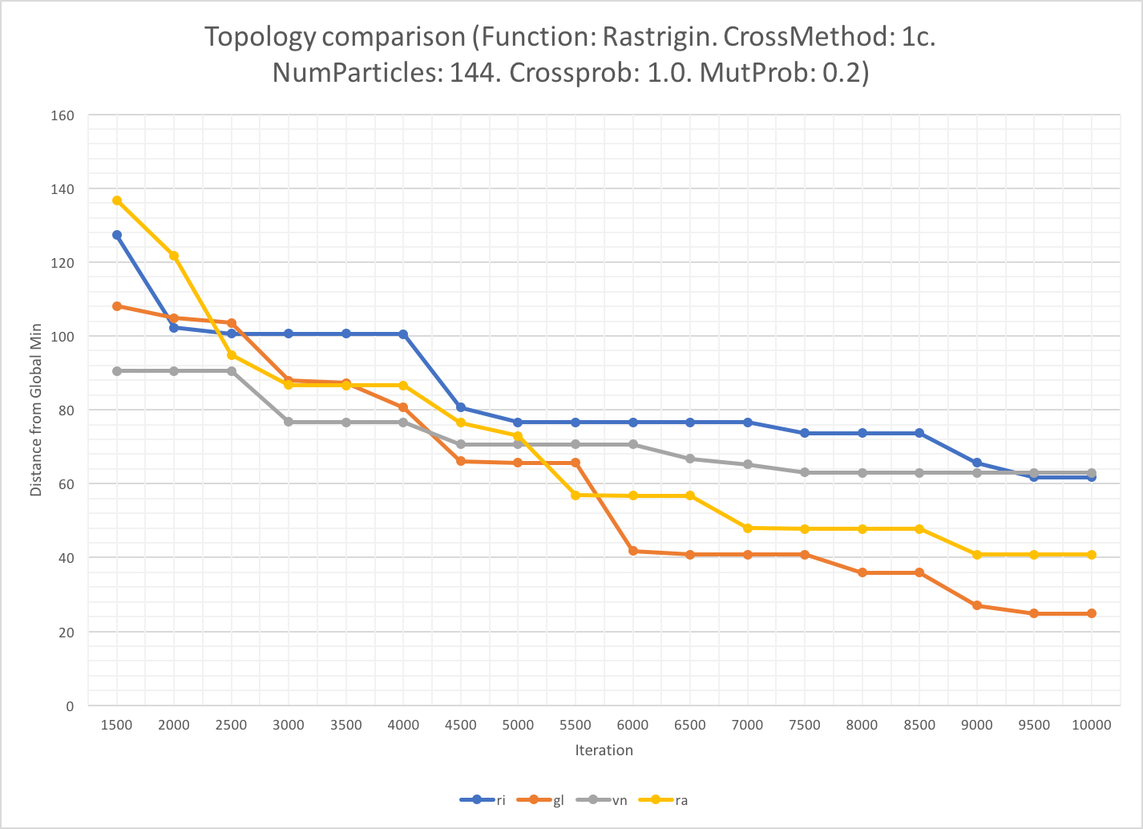
Results: Number of Particles:
144

Slide 18
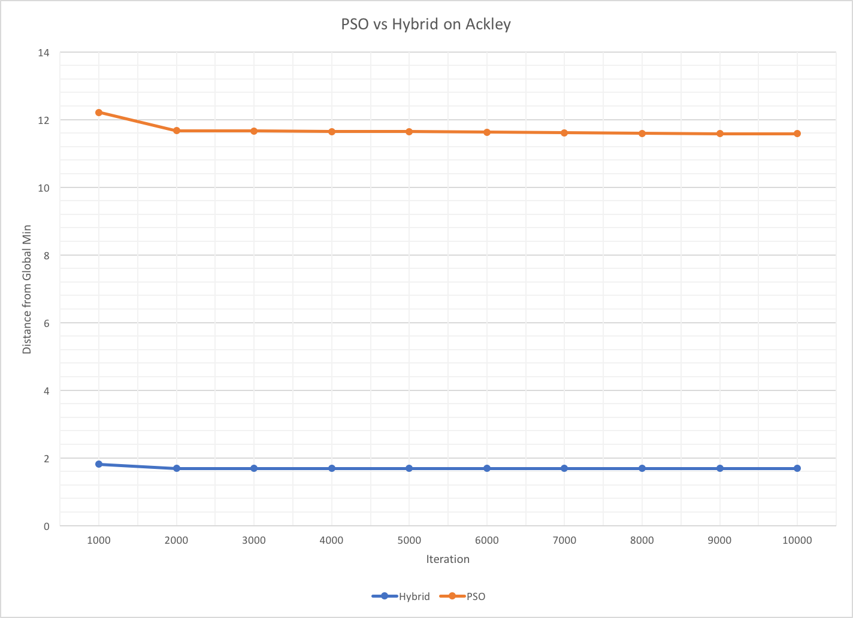
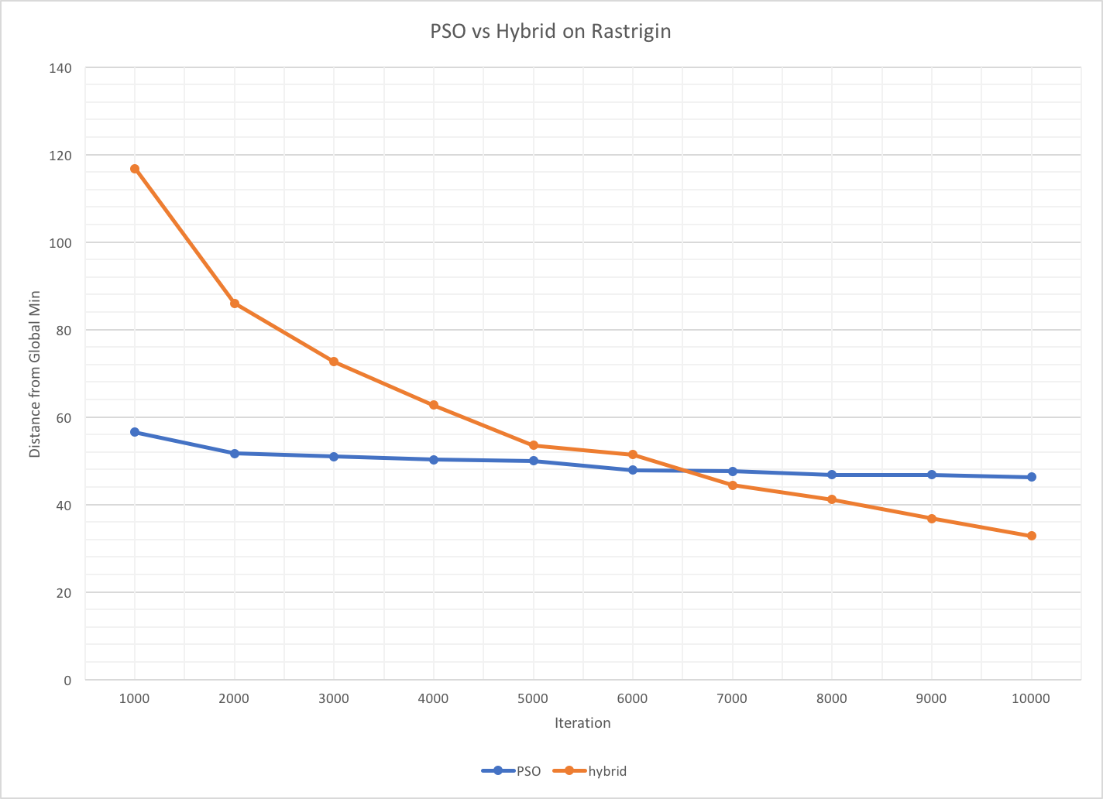
Results: What We Improved

Slide 19
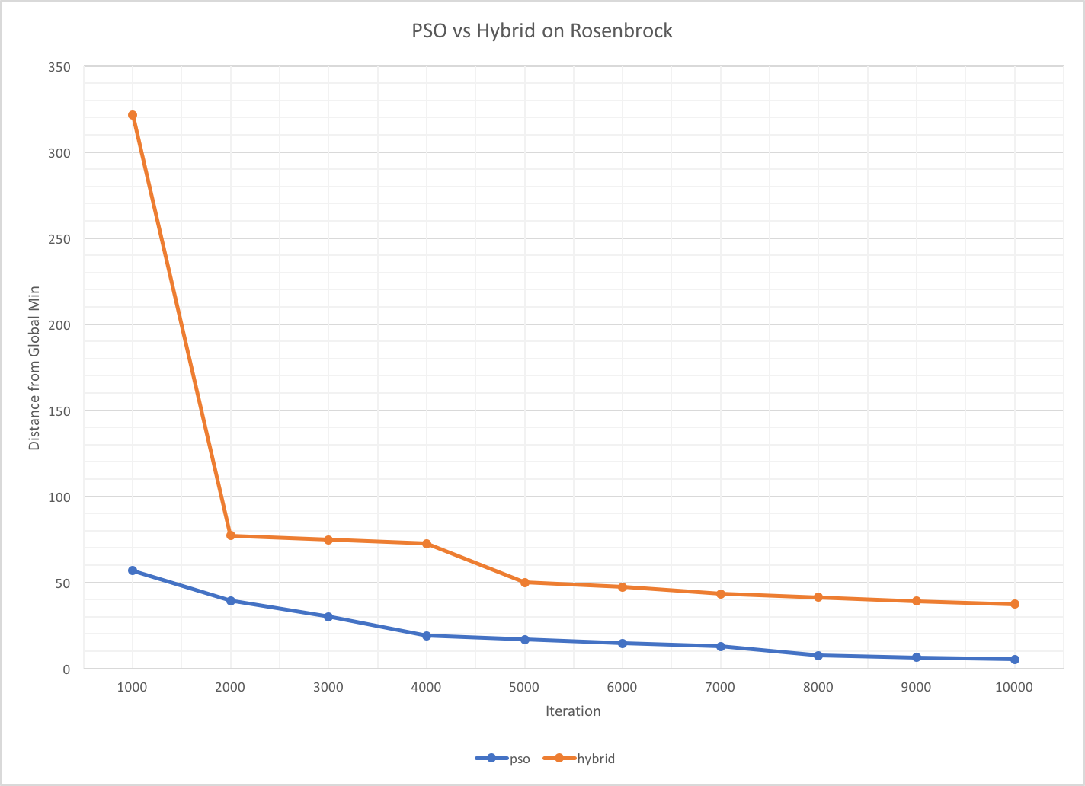
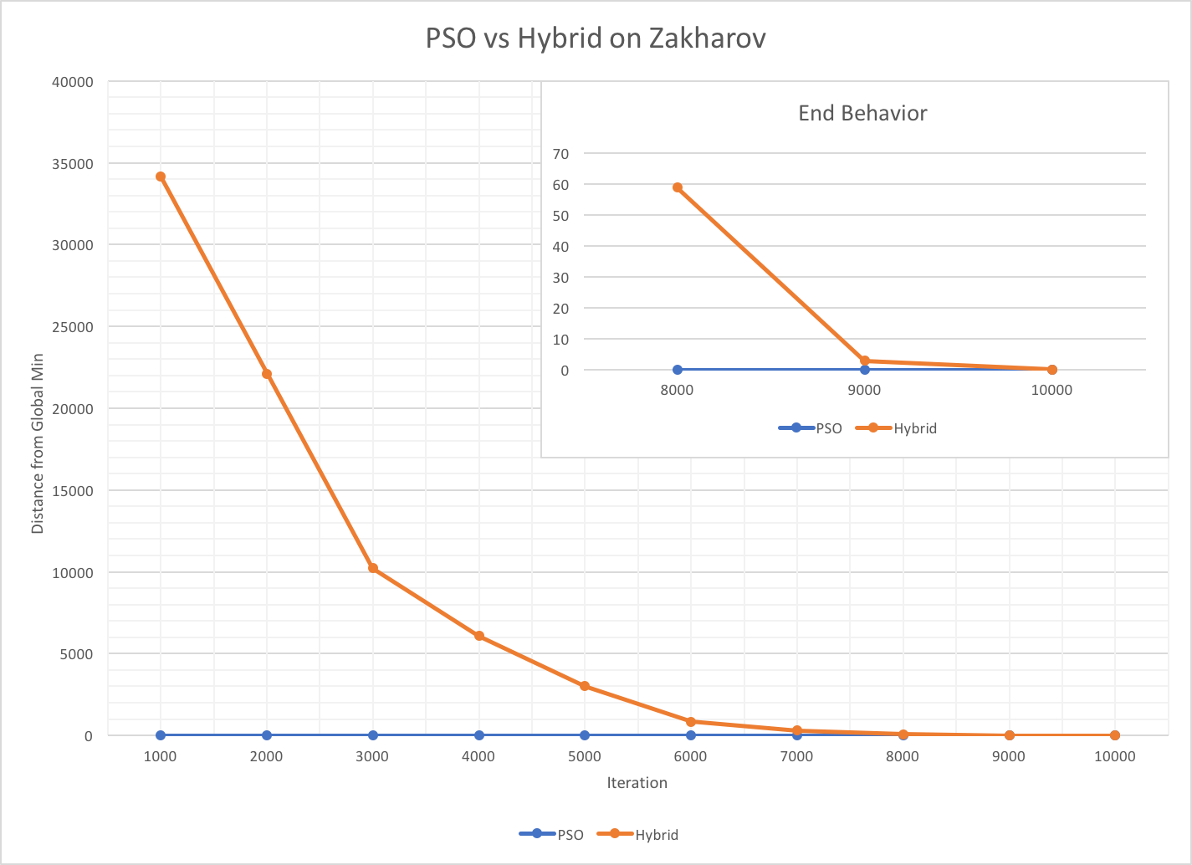
Results: What We Made Worse

Slide 20
Better Neutral Worse
d

Slide 21
Conclusions:
Improves solution quality for functions with lots of local minima
Increases runtime
Takes longer to converge

Slide 22
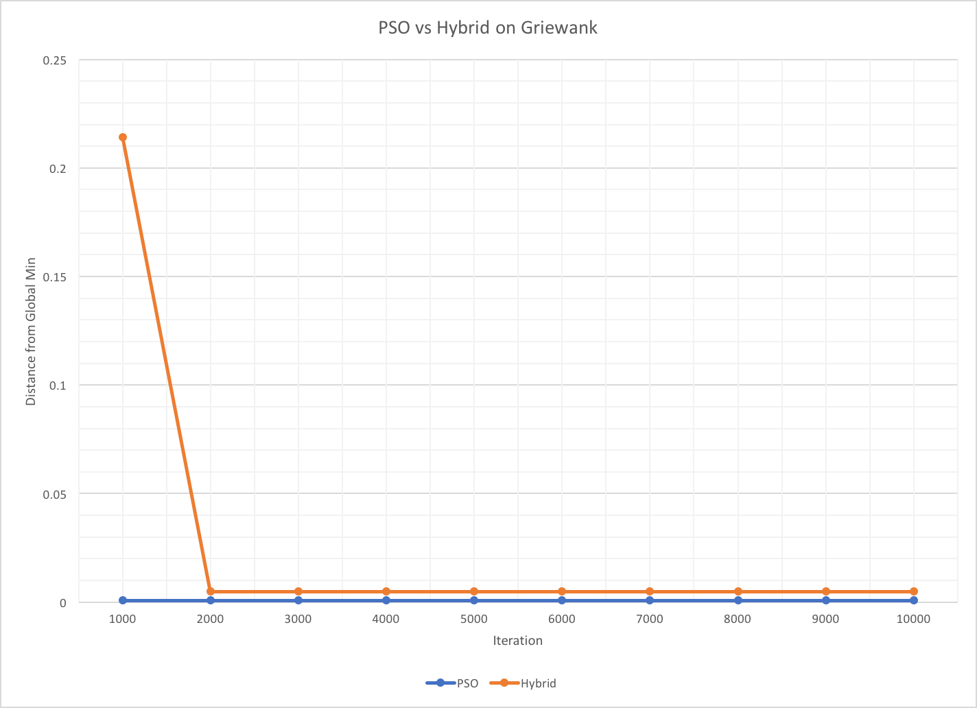
A quick note about Griewank...
Too many local minima - essentially seen as a flat surface
Everything solves it extremely quickly
Has a deep bowl shape (in 3D) that has lots of good values

Slide 23
Further Work
Parameters that vary as iterations increase
Mutation Prob or Cut Ratio
Different Forms of Crossover
Performing PSO on only the particles below the Cut
Examining our conclusions on more functions

Slide 24
Works Cited:
Bratton, D., & Kennedy, J. (2007). Defining a Standard for Particle Swarm Optimization. 2007 IEEE Swarm Intelligence Symposium.
Deep, K., Thakur, M. “A new crossover operator for real coded genetic algorithms.” Applied Mathematics and Computation 188 (2007) 895–911.
Eshelman, L.J., Schaffer, J.D. Real-coded genetic algorithms and interval schemata, in: D.L. Whitley (Ed.), Foundation of Genetic Algorithms II, Morgan Kaufmann, San Mateo, CA, 1993, pp. 187–202.
Herrera, F., Lozano, M. & Verdegay, J. Tackling Real-Coded Genetic Algorithms: Operators and Tools for Behavioural Analysis. Artificial Intelligence Review (1998).
Janikow, C. Z. and Michalewicz, Z. "An Experimental Comparison of Binary and Floating Point Representations in Genetic Algorithms." Paper presented at the meeting of the ICGA, 1991.
Kao, Y., & Zahara, E. (2008). A hybrid genetic algorithm and particle swarm optimization for multimodal functions. Applied Soft Computing, 8(2), 849-857.
Kita, H., Ono, I., and Kobayashi, S. "Theoretical Analysis of the Unimodal Normal Distribution Crossover." Trans. of the Society of Instrument and Control Engineers, Vol.E-2, No.1, 187/194 (2002).

